Slide 1
Social Media
NLP
for
Social Media
Social Media
for
Crisis
NLP
Crisis
NLP
for
Crisis
Scope of this manuscript

Slide 2
National crisis cell
Response Teams
Information System
Regional crisis cell
Information processing & mngt
Decision makers
IS Operators
Rescue managers
External sources of information
Local crisis cell
Rescue operators
Information flow

Slide 3
Hub
Community

Slide 4
Danger
Risks
Stakes
Consequence
Event

Slide 5



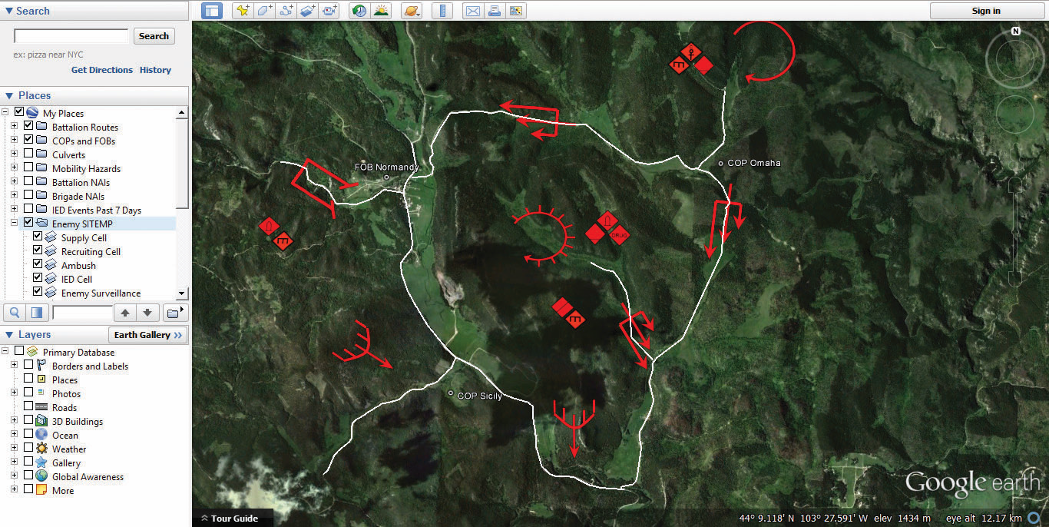







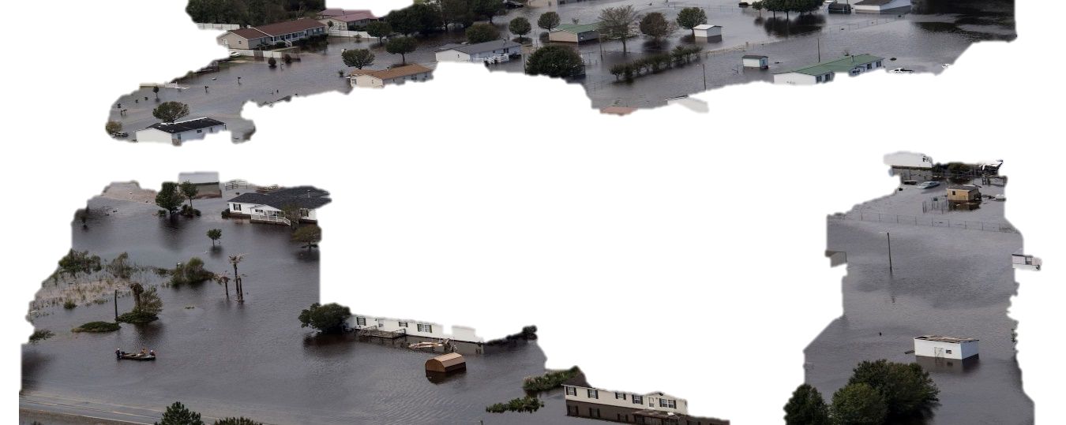
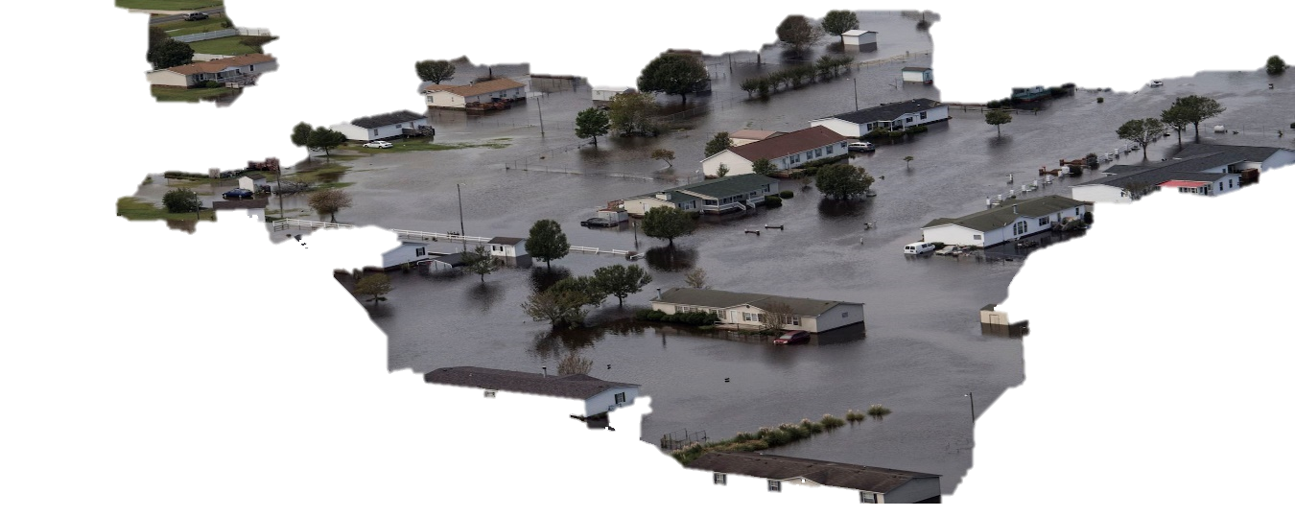




Crisis cell
Decisions
COP
3
1
2
Real World — Crisis Event
Virtual World Social Media

